Slide 1
Chapter 6
The Relational Data Model and
Relational Algebra
Relational Model Concepts
Characteristics of Relations
Relational Integrity Constraints
  Key Constraints
  Entity Integrity Constraints
  Referential Integrity Constraints
Update Operations on Relations

Slide 2
（Cont.）
Relational Algebra Operations
  SELECT σ and PROJECT π
  Set Operations
  JOIN Operations
  Additional Relational Operations

Slide 3
1. Relational Model Concepts
Relation（Informally）:A table of values.Each column in the table has a column header called an attribute. Each row is called a tuple.
Formal Relational Concepts:
  Domain:A set of atomic(indivisible)values.
  Attribute:A name to suggest the meaning that a domain plays in a particular relation.Each attribute A_{i} has a domain dom(A_{i}).
  Relation schema:A relation name R and a set of attributes A_{i} that define the relation.

Slide 4
(cont.)
Denoted by：R(A₁,A₂,…,A_{n})
Example：STUDENT(Name,SSN,BirthDate,Addr）
  Degree of a relation：Its number of attributes n.
  Tuple t （of R(A₁,A₂,…,A_{n}））：A(ordered) set of values t = < V₁,V₂,…,V_{n}> where each value V_{i} is an element of dom (A_{i}). Also called an n-tuple.
  Relation instance r(R)：A set of tuples.
  r(R) = {t₁,t₂,…,t_{m}}, or alternatively
  r(R) ⊂ dom(A₁) × dom(A₂ ) × …. × dom(A _{n})

Slide 5
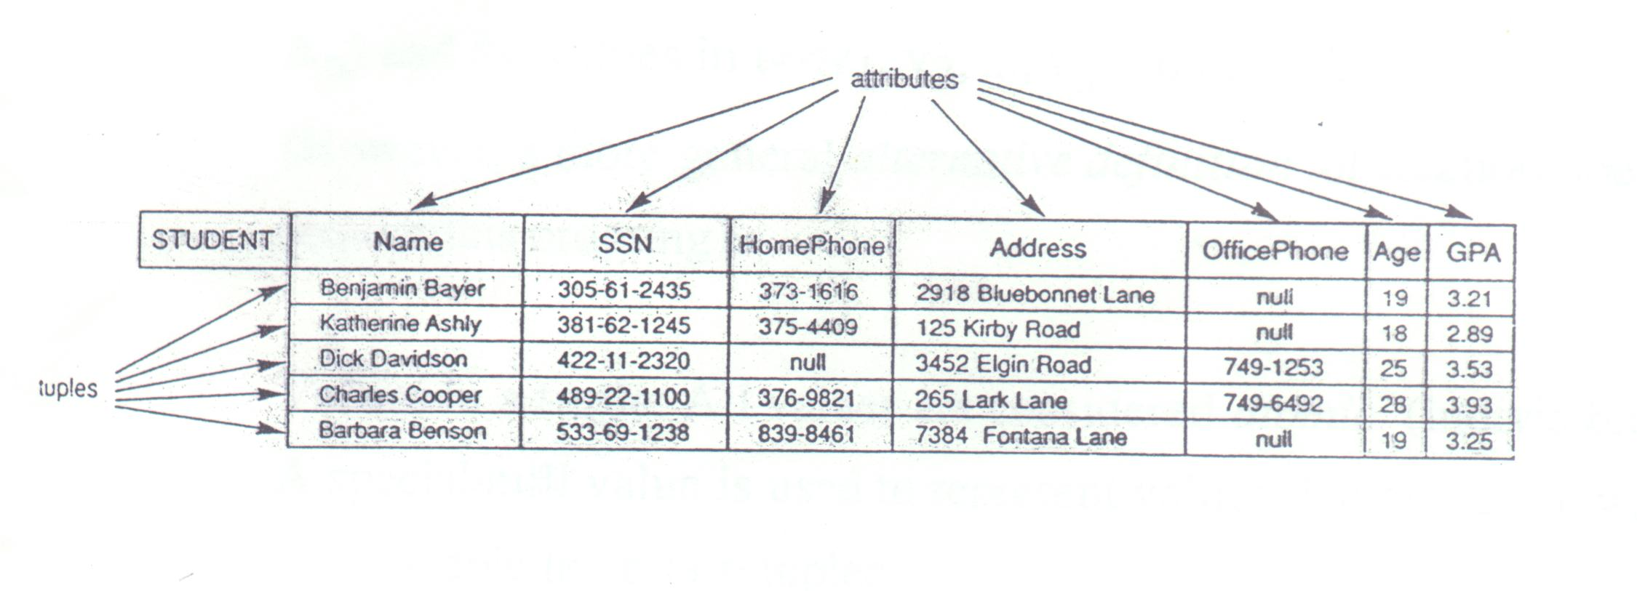
Figure 7.1

Slide 6
2 Characteristics of Relations
Ordering of tuples in a relation r(R) :
The tuples are not considered to be ordered, even though they appear to be in the tabular form.
Ordering of attributes in a relation schema R (and of values within each tuple ) : We will consider the attributes in R(A₁ ,A₂ … A _{n}) and the values in t = <v₁,v₂,…v_{n}> to be ordered.

Slide 7
（Cont.）
(However , a more general alternative definition of relation does not require this ordering).
Values in a tuple : All values are considered atomic (indivisible).
A special null value is used to represent values that are unknown or inapplicable to certain tuples.
Notation:
-We refer to component values of a tuple t by t[A_{i}]

Slide 8
（Cont.）
  = v_{i} (the value for attribute AI for tuple t ).
  Similarly, t [A_{u},A_{v},…,A_{w}] refers to the subtuple fo t containing the values of attributes A_{u},A_{v},…,A_{w} respectively.

Slide 9
3 Relational Integrity Constraints
Constraints are conditions that must hold on all valid relation instances. There are three main types of constraints.

Slide 10
3.1 Key constraints
Superkey of R : A set of attributes SK of R such that no two tuples in any valid relation instance r(R) will have the same value for SK.
That is, for any distinct tuples t1 and t2 in r (R),t₁[SK]≠t₂[SK].
Key of R:〝minimal〞superkey; that is , a superkey K such that removal of any attribute from K results in a set of attributes that is not a superkey.
Example: The CAR relation schema:

Slide 11
（Cont.）
CAR(State, Reg#, SerialNo, Make,Model,Year)
has tow keys key1={State, Reg#}, Key2={SerialNo}, which are also superkeys. {SerialNo, Make} is a superkey but not a key.
If a relation has several candidate keys, one is chosen arbitrarily to be the primary key. The primary key attributes are underlined.

Slide 12
3.2 Entity Integrity
Relation Database Schema: A set S of relation schemas that belong to the same database. S is the name of the database.
S = {R₁, R₂, …, R_{n}}
Entity Integrity: The primary key attributes PK of each relation schema R in S cannot have null values in any tuple of r(R). This is because primary key values are used to identify the individual tuples
t[PK] ≠ null for any tuple t in r(R)

Slide 13
(cont.)
Note: Other attributes of R may be similarly constrained to disallow null values, even though they are not members of the primary key.

Slide 14
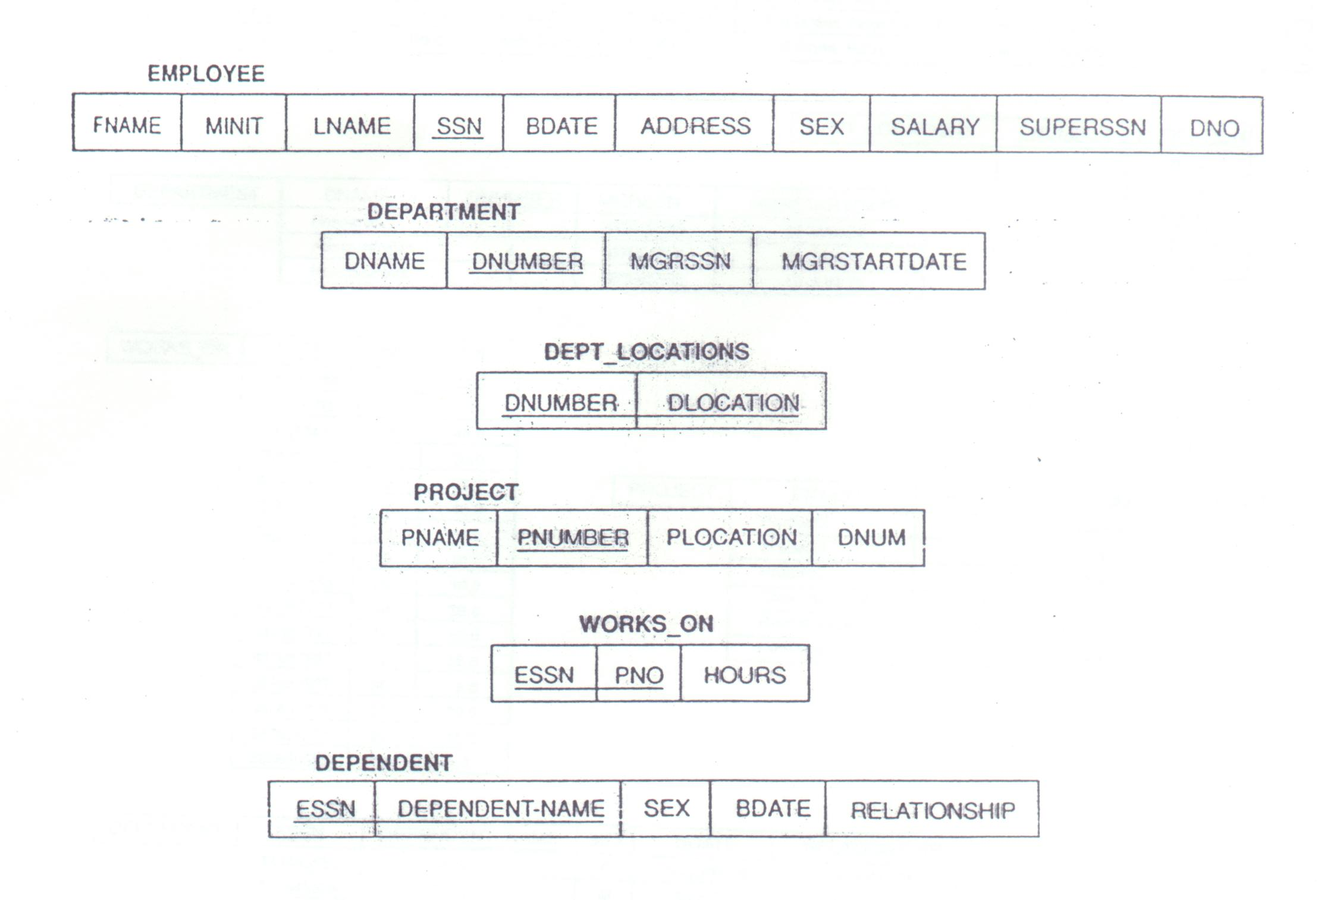
Figure 7.5

Slide 15
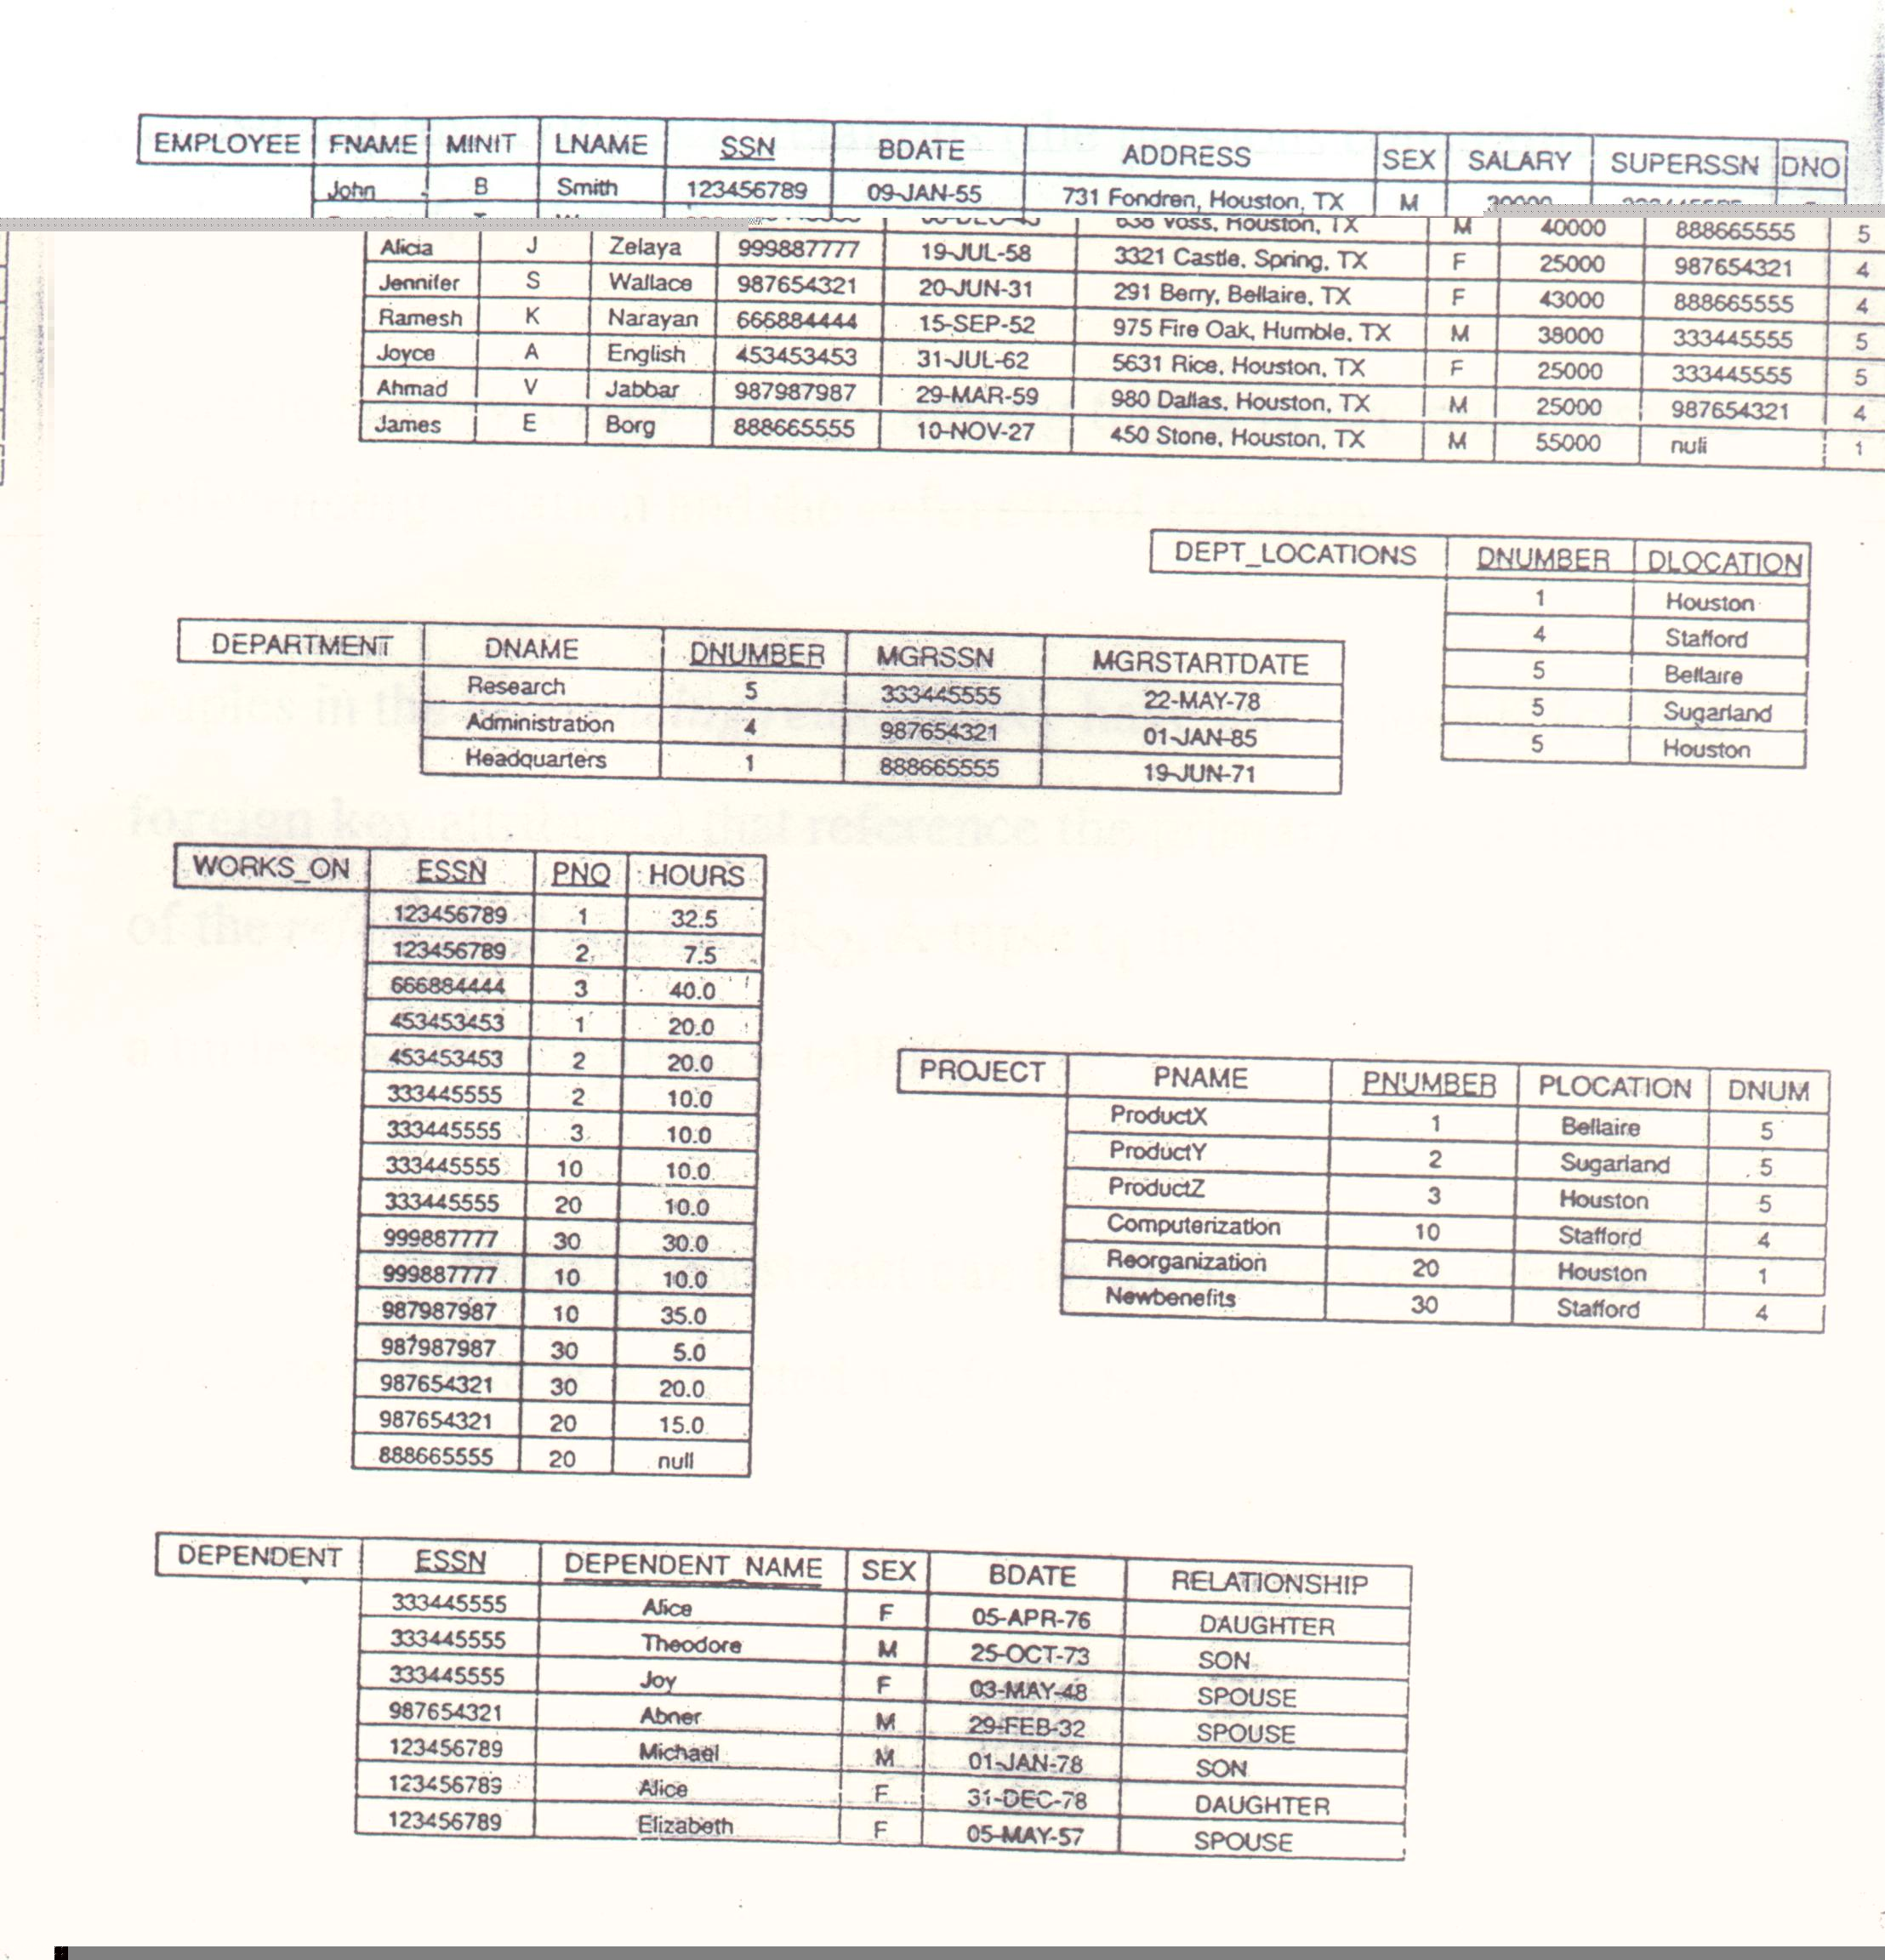
Figure 7.6

Slide 16
3.3 Referential Integrity
A constraint involving two relations(the previous constraints involve a single relation)
Used to specify a relationship among tuples in two relations: the referencing relation and the referenced relation
Tuples in the referencing relation R₁ have attributes FK(called foreign key attributes) that reference the primary key attributes PK of the referenced relation R₂. A tuple t1 in R1 is said to reference a tuple t₂ in R₂ if t₁[FK] = t₂[PK]

Slide 17
(cont.)
A referential integrity constraint can be displayed in a relational database schema as a directed are from R₁ FK to R₂.

Slide 18
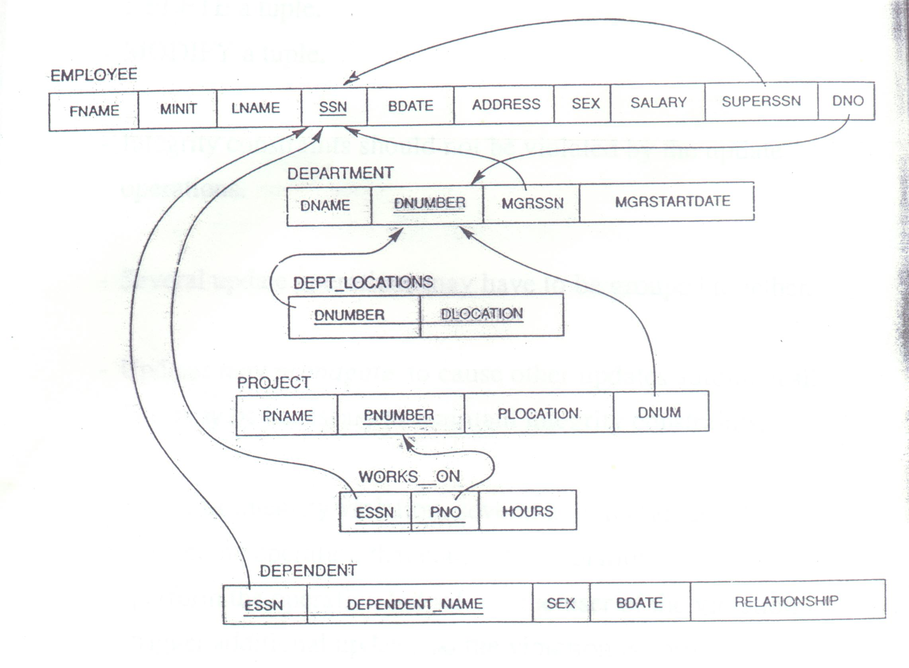
Figure 7.7

Slide 19
4 Update Operations on Relations
INSERT a tuple
DELETE a tuple
MODIFY a tuple
Integrity constraints should not be violated by the update operations
Several update operations may have to be grouped together
Updates may propagate to cause other updates automatically. This may be necessary to maintain integrity constraints.

Slide 20
(cont.)
In case of integrity violation, several actions can be taken:
  Cancel the operation that causes the violation
  Perform the operation but inform the user of the violation
  Trigger additional updates so the violation is corrected
  Execute a user-specified error-correction routine

Slide 21
5. The Relational Algebra
Operations to manipulate relations
Used to specify retrieval requests(queries)
Query result is in the form of a relation
Relational Operations:
  SELECT σ and PROJECT π
  Set operations: These include UNION ∪, INTERSECTION ∩, DIFFERENCE −, CARTESIAN PRODUCT ×
  JOIN operations
  Other relational operations: DIVISION, OUTER JOIN, AGGREGATE FUNCTIONS

Slide 22
5.1 SELECT σ and PROJECT π
SELECT operation(denoted by σ ):
  Selects the tuples(rows) from a relaion R that satisfy a certain selection condition c
  Form of the operation: σ_{c}(R)
  The condition c is an arbitrary Boolean expression on the attributes of R
  Resulting relation has the same attributes as R
  Resulting relation includes each tuple in r(R) whose attribute values satisfy the condition c
  Examples:
  σ_{DNO = 4}(EMPLOYEE)
  σ_{SALARY > 30000}(EMPLOYEE)
  σ(DNO = 4 AND SALARY>25000) OR DNO = 5(EMPLOYEE)

Slide 23
(cont.)
PROJECT operation (denoted by π):
  Keeps only certain attributes(columns) from a relation R specified in an attribute list L
  Form of operation : π_{L}(R)
  Resulting relation has only those attributes of R specified in L
  Example: π_{FNAME, LNAME, SALARY}(EMPLOYEE)
  The PROJECT operation eliminates duplicate tuples in the resulting relation so that it remains a mathematical set ( no duplicate elements)

Slide 24
(cont.)
  Example: π_{SEX, SALARY}(EMPLOYEE)
  If several male employees have salary 30000, only a single tuple <M, 30000> is kept in the resulting relation
  Duplicate tuples are eliminated by the πoperation
  Sequences of operations:
  Several operations can be combined to form a relational algebra expression(query)
  Example: Retrieve the names and salaries of employees who work in department 4:
  π_{FNAME, LNAME, SALARY}(σ_{DNO = 4}(EMPLOYEE))

Slide 25
(cont.)
  Alternatively, we specify explicit intermediate relations for each step:
  DEPT4_EMPS ← σ_{DNO = 4}(EMPLOYEE)
  R ← π_{FNAME, LNAME, SALARY}(DEPT4_EMPS)
  Attributes can optionally be renamed in the resulting left-hand-side relation(this may be required for some operations that will be presented later):
  DEPT4_EMPS ← σ_{DNO = 4}(EMPLOYEE)
  R(FIRSTNAME, LASTNAME, SALARY) ←
  π_{FNAME, LNAME, SALARY}(DEPT4_EMPS)

Slide 26
RENAME Operation
The RENAME operator is denoted by ρ (rho)
In some cases, we may want to rename the attributes of a relation or the relation name or both
  Useful when a query requires multiple operations
  Necessary in some cases (see JOIN operation later)

Slide 27
RENAME Operation (contd.)
The general RENAME operation ρ can be expressed by any of the following forms:
  “ρ_{S}(R)” changes:
    the relation name from R to S
  “ρ_{(B1, B2, …, Bn )}(R)” changes:
    the column (attribute) names to B1, B1, …..Bn
  “ρ_{S (B1, B2, …, Bn )}(R)” changes both:
    the relation name to S, and
    the column (attribute) names to B1, B1, …..Bn

Slide 28
5.2 Set Operations
Binary operations from mathematical set theory:
  UNION: R₁∪R₂,
  INTERSECTION: R₁∩R₂,
  SET DIFFERENCE: R₁−R₂,
  CARTESIAN PRODUCT: R₁×R₂
For ∪, ∩, −, the operand relations R₁(A₁, A₂, …, A_{n}) and R₂(B₁, B₂, …, B_{n}) must have the same number of attributes, and the domains of corresponding attributes must be compatible; that is, dom(A_{i}) = dom(B_{i}) for I = 1,2,…,n. This condition is called union compatibility

Slide 29
(cont.)
The resulting relation for ∪, ∩, or − has the same attribute names as the first operand relation R₁ (by convention)

Slide 30
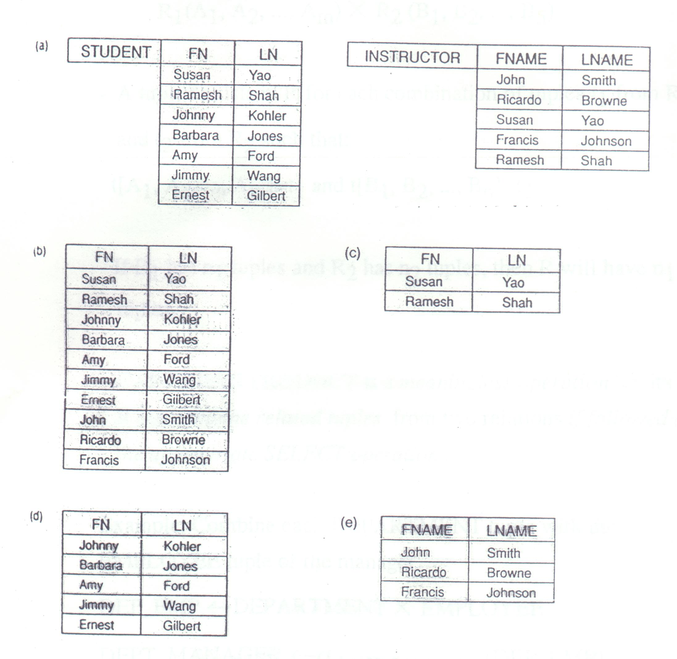
Figure 7.11

Slide 31
(cont.)
CARTESIAN PRODUCT
  R(A₁, A₂, …, A_{m}, B₁, B₂, …, B_{n}) ← R₁(A₁,A₂,…, A_{m}) × R₂(B₁, B₂, …, B_{n})
  A tuple t exists in R for each combination of tuples t1 from R1 and t2 from R2 such that:
  t[A₁, A₂, …, A_{m}] = t₁ and t[B₁, B₂, …, B_{n}] = t₂
  If R₁ has n₁ tuples and R₂ has n₂ tuples, then R will have n₁*n₂ tuples
  CARTESIAN PRODUCT is a meaningless operation on its own.It can combine related tuples from two relations if followed by the appropriate SELECT operation.

Slide 32
(cont.)
  Example: Combine each DEPARTMENT tuple with the EMPLOYEE tuple of the manager
  DEP_EMP ← DEPARTMENT × EMPLOYEE
  DEPT_MANAGER ← σ_{MGRSSN = SSN}(DEP_EMP)

Slide 33
5.3 JOIN Operations
THETA JOIN: Similar to a CARTESIAN PRODUCT followed by a SELECT. The condition c is called a join condition
  R(A₁, A₂, …, A_{m}, B₁, B₂, …, B_{n}) ←
  R₁(A₁,A₂,…, A_{m}) _{c} R₂(B₁, B₂, …, B_{n})
EQUIJOIN: The join condition c includes one or more equality comparisons involving attributes from R1 and R2. That is, c is of the form:
  (A_{i} = B_{j}) AND … AND (A_{h} = B_{k}); 1≤ i,h ≤m, 1 ≤ j,k ≤n

Slide 34
(cont.)
In the above EQUIJOIN operation:
A_{i},…,A_{h} are called the join attributes of R₁
B_{j},…,B_{k} are called the join attributes of R₂
Example of using EQUIJOIN:
  Retrieve each DEPARTMENT’s name and its manager’s name:
  T ← DEPARTMENT _{MGRSSN = SSN} EMPLOYEE
  RESULT ← π_{DNAME,FNAME, LNAME,}(T)

Slide 35
(cont.)
NATURAL JOIN(*):
  In an EQUIJOIN ← R_{1 c} R₂,the join attribute of R2 appear redundantly in the result relation R. In a NATURAL JOIN, the redundant join attributes of R2 are eliminated from R. The equality condition is implied and need not be specified.
  R ← R₁∗c(join attributes of R1),(join attributes of R2) R₂
  Example: Retrieve each EMPLOYEE’s name and the name of the DEPARTMENT he/she works for:
  T ← EMPLOYEE∗_{(DNO),(DNUMBER)} DEPARTMENT
  RESULT ← π_{FNAME, LNAME,DNAME}(T)

Slide 36
(cont.)
  If the join attributes have the same names in both relations, they need not be specified and we can write R ← R₁∗ R₂
  Example: Retrieve each EMPLOYEE’s name and the name of his/her SUPERVISOR:
  SUPERVISOR(SUPERSSN,SFN,SLN) ←
  π_{SSN,FNAME,LNAME}(EMPLOYEE)
  T ← EMPLOYEE ∗ SUPERVISOR
  RESULT ← π_{FNAME, LNAME,SFN,SLN}(T)

Slide 37
(cont.)
  Note: In the original definition of NATURAL JOIN, the join attributes were required to have the same names in both relations
  There can be a more than one set of join attributes with a different meaning between the same two relations. For example:
  JOIN ATTRIBUTES RELATIONSHIP
  EMPLOYEE.SSN = EMPLOYEE manages
  DEPARTMENT.MGRSSN the DEPARTMENT
  EMPLOYEE.DNO = EMPLOYEE works for
  DEPARTMENT.DNUMBER the DEPARTMENT

Slide 38
(cont.)
  Example: Retrieve each EMPLOYEE’s name and the name of the DEPARTMENT he/she works for:
  T ← EMPLOYEE _{DNO = DNUMBER} DEPARTMENT
  RESULT ← π_{FNAME, LNAME,DNAME}(T)
  A relation can have a set of join attributes to join it with itself:
  JOIN ATTRIBUTES RELATIONSHIP
  EMPLOYEE(1).SUPERSSN EMPLOYEE(2) supervises
  = EMPLOYEE(2).SSN EMPLOYEE(1)

Slide 39
(cont.)
  One can think of this as joining two distinct copies of the relation, although only one relation actually exists
  In this case, renaming can be useful
  Example: Retrieve each EMPLOYEE’s name and the name of his/her SUPERVISOR:
  SUPERVISOR(SSN,SFN,SLN) ←
  π_{SSN,FNAME,LNAME}(EMPLOYEE)
  T ← EMPLOYEE _{SUPERSSN = SSN} SUPERVISOR
  RESULT ← π_{FNAME, LNAME,SFN,SLN}(T)

Slide 40
DIVISION
DIVISION Operation
  R(Z) ÷ S(X), where X subset Z. Let Y = Z - X (and hence Z = X ∪ Y); that is, let Y be the set of attributes of R that are not attributes of S.
  The result of DIVISION is a relation T(Y) that includes a tuple t if tuples t_{R} appear in R with t_{R} [Y] = t, and with
    t_{R} [X] = t_{s} for every tuple t_{s} in S.
  For a tuple t to appear in the result T of the DIVISION, the values in t must appear in R in combination with every tuple in S.

Slide 41
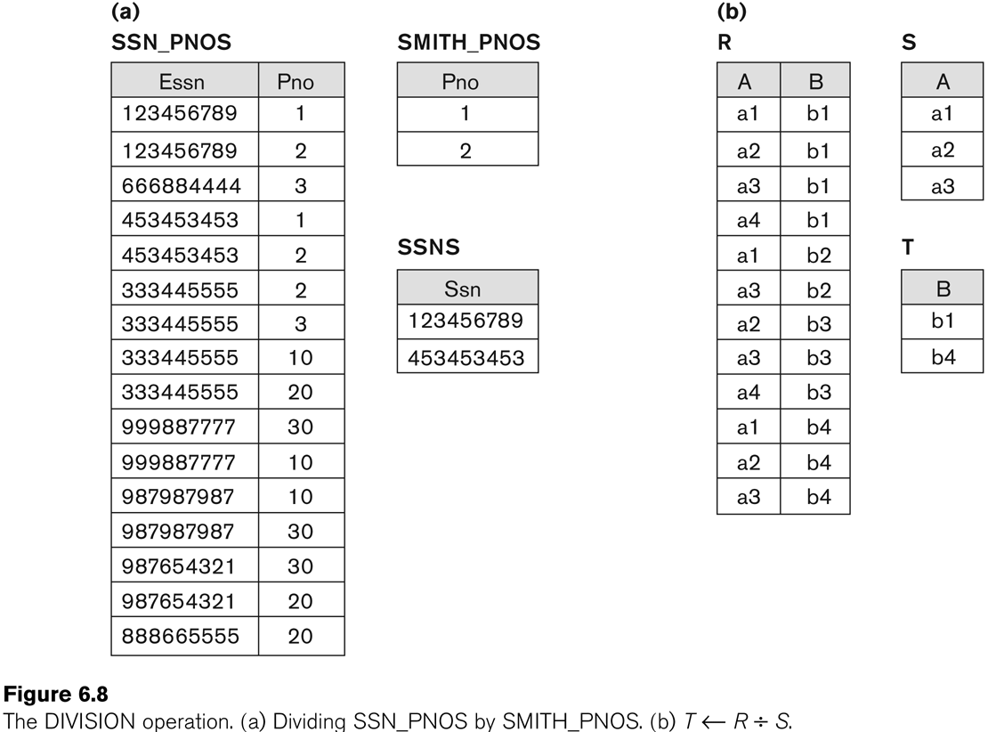
Example of DIVISION

Slide 42
(cont.)
Complete Set of Relational Algebra Operations:
  All the operations discussed so far can be described as a sequence of only the operations SELECT, PROJECT, UNION, SET DIFFEREENCE, and CARTESIAN PRODUCT.
  Hence, the set {σ, π, ∪, −, ×} is called a complete set of relational algebra operations. Any query language equivalent to these operations is called relationally complete.
    R ∩ S = (R ∪ S ) – ((R − S) ∪ (S − R))
    R _{c} S = σ_{c} (R × S)

Slide 43
Query Tree Notation
Query Tree
  An internal data structure to represent a query
  Standard technique for estimating the work involved in executing the query, the generation of intermediate results, and the optimization of execution
  Nodes stand for operations like selection, projection, join, renaming, division, ….
  Leaf nodes represent base relations
  A tree gives a good visual feel of the complexity of the query and the operations involved
  Algebraic Query Optimization consists of rewriting the query or modifying the query tree into an equivalent tree.

Slide 44
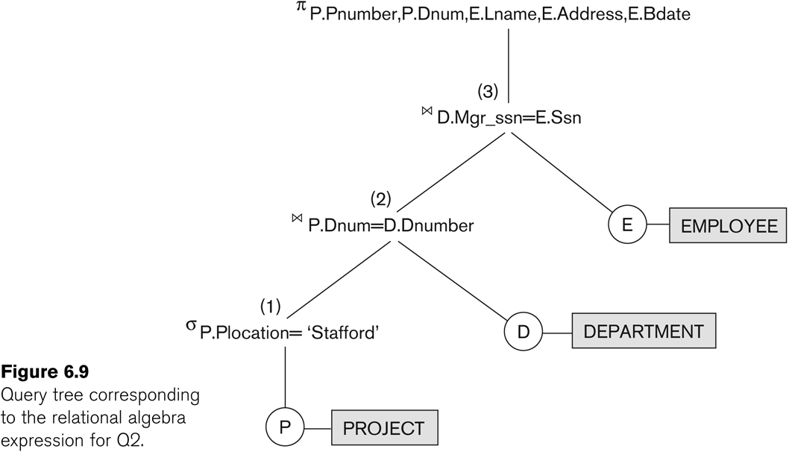
Example of Query Tree

Slide 45
5.4 Additional Relational Operations
For database applications, additional operations are needed that were not part of the original relational algebra. These include:
  Aggregate functions and grouping
  OUTER JOIN and OUTER UNION

Slide 46
AGGREGATE FUNCTIONS
  Functions such as SUM, COUNT, AVERAGE, MIN, MAX are often applied to sets of values or sets of tuples in database applications
  <grouping attributes> ℑ <function list> (R)
  The grouping attributes are optional
  Example 1: Retrieve the average salary of all employees(no grouping needed):
  R(AVGSAL) ← ℑ_{AVERAGE SALARY}(EMPLOYEE)

Slide 47
(cont.)
  Example 2: For each department, retrieve the department number, the number of employees, and the average salary ( in the department):
  R(DNO, NUMEMPS, AVGSAL) ←
  _{DNO} ℑ_{COUNT SSN,AVERAGE SALARY}(EMPLOYEE)
  DNO is called the grouping attribute in the above example

Slide 48
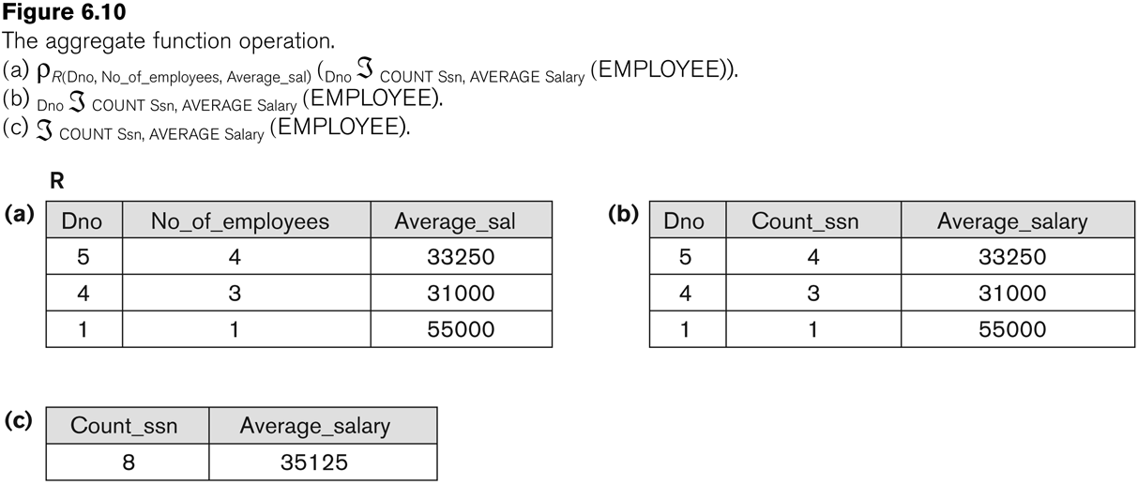
Examples of applying aggregate functions and grouping

Slide 49
(cont.)
OUTER JOIN
  In a regular EQUIJOIN or NATURAL JOIN operation, tuples in R₁ or R₂ that do not have matching tuples in the other relation do not appear in the result
  Some queries require all tuples in R₁(or R₂ or both) to appear in the result
  When no matching tuples are found, nulls are placed for the missing attributes
  LEFT OUTER JOIN: R₁ R₂ lets every tuple in R₁ appear in the result
  RIGHT OUTER JOIN: R₁ R₂ lets every tuple in R₂ appear in the result

Slide 50
(cont.)
  FULL OUTER JOIN: R₁ R₂ lets every tuple in R₁ or R₂ appear in the result

Slide 51
OuterUnion
No notation for “outer union”.
R(X,Y) and S(X,Z) are partially compatible (because only X is common to both relations).
R(X,Y) OUTER UNION S(X,Z) = T(X,Y,Z)
  Add Z to R and put ‘null’ to all R.Z ➔ R(X,Y,Z)
  Add Y to S and put ‘null’ to all S.Y ➔ S(X,Y,Z)
  Perform a normal union
  T(X,Y,Z) = R(X,Y,Z) UNION S(X,Y,Z)
A trouble: what’s the difference between these ‘nulls’ and those unknown values (such as address unknown). 例: Y 是 address. S 沒有 Y. 結果從 T 中找出沒有 address 的人，但這些人
  若屬S 的，他們可能有 address, 只是當初沒有此 attribute 來存放；
  若屬R 的，那他們真正是沒有 address 的人 (或至少到目前為止，address 是 unknown.

Slide 52
Outer Intersection/Difference
R(X,Y) OUTER INTERSECT S(X,Z)
  R(X,Y,Z) INTERSECT S(X,Y,Z) = Empty
  This is because all R.Z values are ‘null’, which is not equal to S.Z (if none of S.Z is a ‘null’).
R(X,Y) OUTER DIFFERENCE S(X,Z)
➔ R(X,Y,Z) DIFFERENCE S(X,Y,Z) = R(X,Y,Z)
As ‘outer intersection’ (almost) always gives empty results and ‘outer difference’ (almost) always gives a result of the first relation, outer set operations (including outer union) are rarely used.

